Slide 1
Dynamic Programming

Slide 2
狀態轉移
狀態：定義一個N維陣列來記錄值
sum[i]紀錄a[1]~a[i]的和
轉移：用現有的值推出其他的值
sum[i] = sum[i – 1] + a[i]
邊界條件要設好
轉態轉移是影響整個複雜度的關鍵

Slide 3
經典題目
背包
LCS
LIS
數位DP
輪廓線/插頭DP

Slide 4
優化
滾動陣列
矩陣快速冪優化
狀態壓縮
單調性優化(利用資料結構/STL)
凸包優化

Slide 5
背包問題
題目背包問題中，會給你背包的容量C，以及N種物品，它們有不同的重量w和價值v，背包裡物品價值總和最大為何?

Slide 6

背包問題
0/1背包：每種物品最多可以放1個
無限背包：每種物品可以放無限多個
有限背包：每種物品最多可以放$L_{i}$個

Slide 7
0/1背包
我們先根據N和C定義狀態
dp[i][j] = 使用1到i 個物品湊出重量 j 時,所可得到的最大價值。

Slide 8
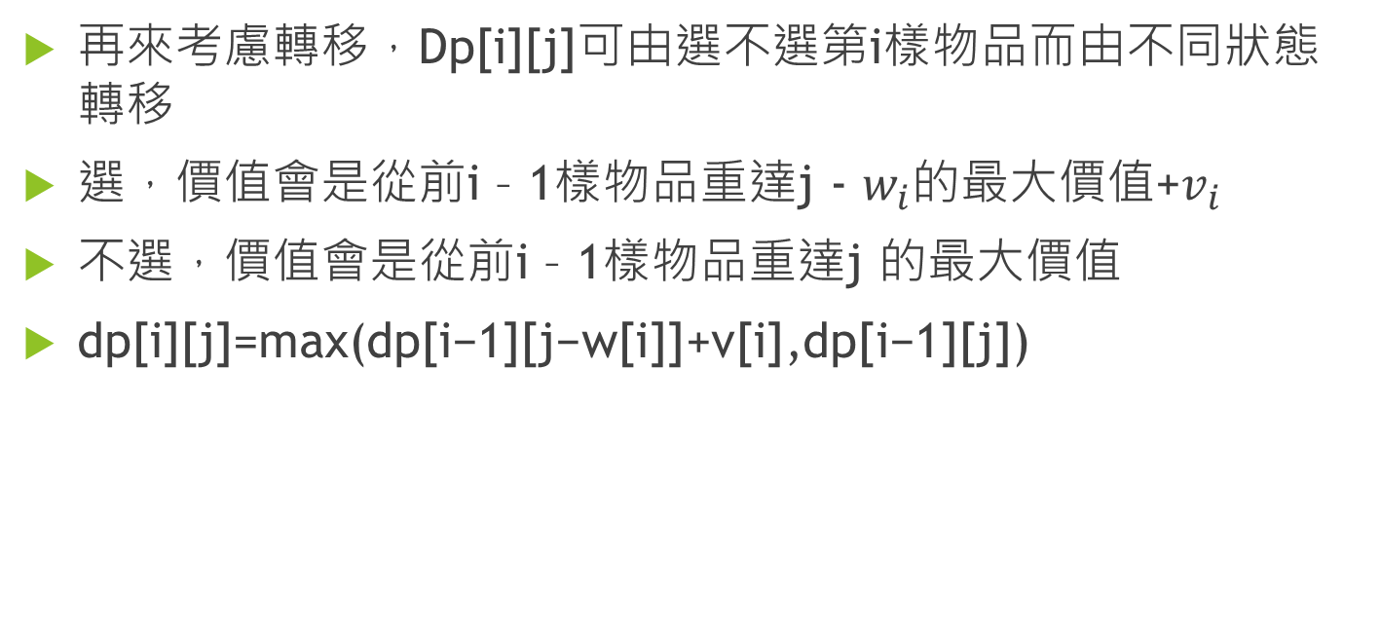
0/1背包
再來考慮轉移，Dp[i][j]可由選不選第i樣物品而由不同狀態轉移
選，價值會是從前i – 1樣物品重達j - $w_{i}$的最大價值+$v_{i}$
不選，價值會是從前i – 1樣物品重達j 的最大價值
dp[i][j]=max(dp[i−1][j−w[i]]+v[i],dp[i−1][j])

Slide 9
0/1背包
邊界條件：dp[0][0]=0, dp[0][i] = −INF when i>0

Slide 10
無限背包
我們一樣根據N和C定義狀態
dp[i][j] = 使用1到i 個物品湊出重量 j 時,所可得到的最大價值。

Slide 11
無限背包
轉移式除了剛剛的兩種情況，還有可能從相同物品疊加而成
dp[i][j]=max(dp[i−1][j−w[i]]+v[i],dp[i−1][j],
dp[i][j – w[i]]+v[i])

Slide 12
無限背包
邊界條件：dp[0][0]=0, dp[0][i] = −INF when i>0

Slide 13
LCS (Longest Common Subsequence)
兩個最大長度為N的字串，去除元素後變成相同的序列的最長長度
子序列是指一個序列去除某些元素後所形成的新序列(當然也可以不刪除任何東西)

Slide 14
LCS (Longest Common Subsequence)
abc ac LCS長度為2
abcd acd LCS長度為3

Slide 15
LCS (Longest Common Subsequence)
abc ab LCS長度為2
abc abe LCS長度為2

Slide 16
LCS (Longest Common Subsequence)
abc ab LCS長度為2
abc abb LCS長度為2

Slide 17
LCS (Longest Common Subsequence)
我們可以枚舉分別前綴字串，看看再加元素進去會不會影響LCS長度

Slide 18
LCS (Longest Common Subsequence)
狀態：dp[i][j]使用 a[1~i]和b[1~j]的LCS長度

Slide 19
LCS (Longest Common Subsequence)
轉移：
dp[i][j] = dp[i-1][j-1]+1 if a[i]=b[j]
max(dp[i-1][j],dp[i][j-1]) else

Slide 20
LCS (Longest Common Subsequence)
邊界條件：dp[i][0]=dp[0][i]=0 when i ≥ 0

Slide 21

LCS (Longest Common Subsequence)
時間複雜度：
狀態O($N^{2}$)

Slide 22

LCS (Longest Common Subsequence)
時間複雜度：
狀態O($N^{2}$)
每個狀態用O(1)轉移

Slide 23

LCS (Longest Common Subsequence)
時間複雜度：O($N^{2}$)
狀態O($N^{2}$)
每個狀態用O(1)轉移

Slide 24

LCS (Longest Common Subsequence)
空間複雜度：O($N^{2}$)

Slide 25
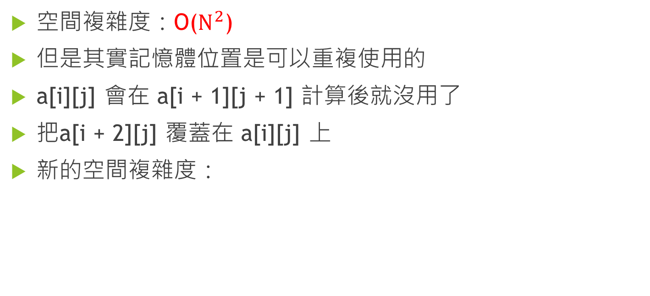
LCS (Longest Common Subsequence)
空間複雜度：O($N^{2}$)
但是其實記憶體位置是可以重複使用的
a[i][j] 會在 a[i + 1][j + 1] 計算後就沒用了
把a[i + 2][j] 覆蓋在 a[i][j] 上
新的空間複雜度：

Slide 26
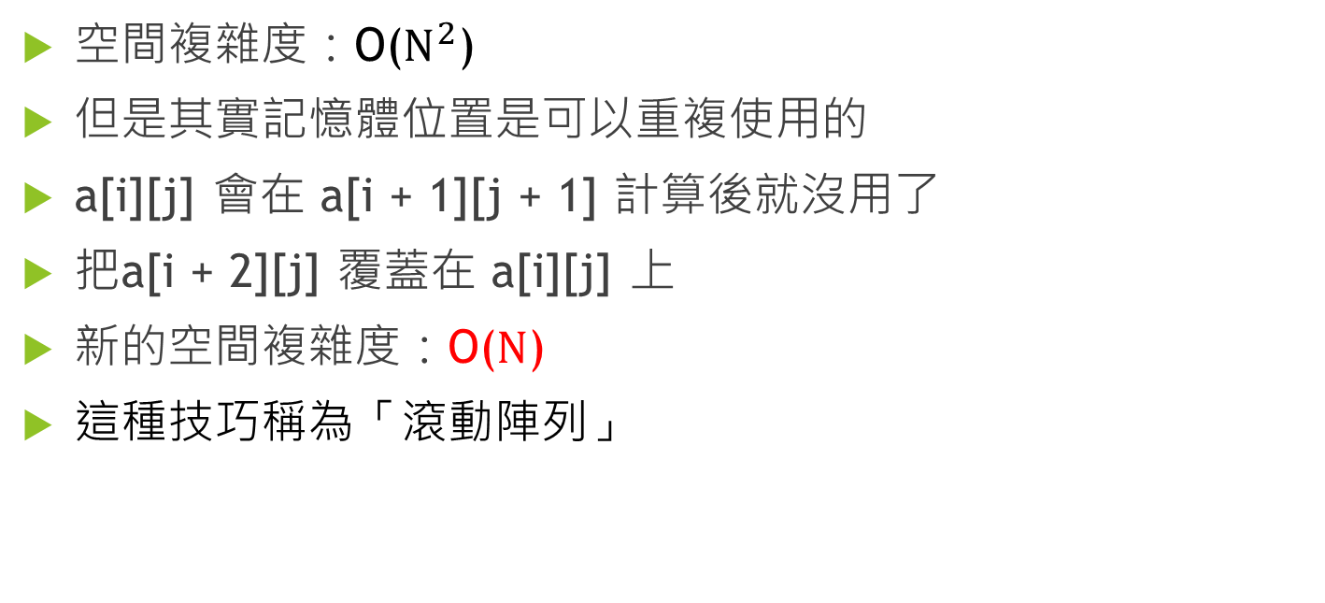
LCS (Longest Common Subsequence)
空間複雜度：O($N^{2}$)
但是其實記憶體位置是可以重複使用的
a[i][j] 會在 a[i + 1][j + 1] 計算後就沒用了
把a[i + 2][j] 覆蓋在 a[i][j] 上
新的空間複雜度：O($N$)
這種技巧稱為「滾動陣列」

Slide 27
滾動陣列
將過期的資訊覆蓋掉
前面的0/1背包和無限背包也可以用

Slide 28
LIS (Longest Increasing Subsequence)
給你一個序列長度為N，求最長遞增子序列的長度

Slide 29
LIS (Longest Increasing Subsequence)
狀態：dp[i]代表序列A前i個數字所能形成LIS之長度

Slide 30
LIS (Longest Increasing Subsequence)
轉移：
dp[i] = max(1, dp[j] + 1) for all j, j <= I and A[j] <(=) A[i]

Slide 31
LIS (Longest Increasing Subsequence)
邊界：dp[0] = 1

Slide 32
LIS (Longest Increasing Subsequence)
時間複雜度：
狀態O(N)

Slide 33
LIS (Longest Increasing Subsequence)
時間複雜度：
狀態O(N)
每個狀態用O(N)轉移

Slide 34

LIS (Longest Increasing Subsequence)
時間複雜度：O($N^{2}$)
狀態O(N)
每個狀態用O(N)轉移

Slide 35
LIS (Longest Increasing Subsequence)
這樣看起來不錯，但還可以在更快
換另一種狀態試試看

Slide 36
LIS (Longest Increasing Subsequence)
狀態：dp[n][i] = 使用 1到n 個數字湊出長度 i 的 LIS,末端數字最小為何。

Slide 37
LIS (Longest Increasing Subsequence)
轉移：
dp[n][i] =
min(dp[n-1][i],a[n]), if a[n]>dp[n-1][i-1]
dp[n−1][i], else

Slide 38
LIS (Longest Increasing Subsequence)
基底：
dp[0][0] = -INF,
dp[0][i] = INF, dp[i][0]=-INF care when i≥1

Slide 39
LIS (Longest Increasing Subsequence)
最後找出最大的j滿足dp[i][j] != INF

Slide 40
LIS (Longest Increasing Subsequence)
A | X | 1 | 3 | 2 | 4 | 6 | 5 | 7
dp |  | 0 | 1 | 2 | 3 | 4 | 5 | 6
0 | -INF | -INF | -INF | -INF | -INF | -INF | -INF | -INF
1 | INF
2 | INF
3 | INF
4 | INF
5 | INF
6 | INF
7 | INF

Slide 41
LIS (Longest Increasing Subsequence)
A | X | 1 | 3 | 2 | 4 | 6 | 5 | 7
dp |  | 0 | 1 | 2 | 3 | 4 | 5 | 6
0 | -INF | -INF | -INF | -INF | -INF | -INF | -INF | -INF
1 | INF | 1
2 | INF | INF
3 | INF | INF
4 | INF | INF
5 | INF | INF
6 | INF | INF
7 | INF | INF

Slide 42
LIS (Longest Increasing Subsequence)
A | X | 1 | 3 | 2 | 4 | 6 | 5 | 7
dp |  | 0 | 1 | 2 | 3 | 4 | 5 | 6
0 | -INF | -INF | -INF | -INF | -INF | -INF | -INF | -INF
1 | INF | 1 | 1
2 | INF | INF | 3
3 | INF | INF | INF
4 | INF | INF | INF
5 | INF | INF | INF
6 | INF | INF | INF
7 | INF | INF | INF

Slide 43
LIS (Longest Increasing Subsequence)
A | X | 1 | 3 | 2 | 4 | 6 | 5 | 7
dp |  | 0 | 1 | 2 | 3 | 4 | 5 | 6
0 | -INF | -INF | -INF | -INF | -INF | -INF | -INF | -INF
1 | INF | 1 | 1 | 1
2 | INF | INF | 3 | 2
3 | INF | INF | INF | INF
4 | INF | INF | INF | INF
5 | INF | INF | INF | INF
6 | INF | INF | INF | INF
7 | INF | INF | INF | INF

Slide 44
LIS (Longest Increasing Subsequence)
A | X | 1 | 3 | 2 | 4 | 6 | 5 | 7
dp |  | 0 | 1 | 2 | 3 | 4 | 5 | 6
0 | -INF | -INF | -INF | -INF | -INF | -INF | -INF | -INF
1 | INF | 1 | 1 | 1 | 1
2 | INF | INF | 3 | 2 | 2
3 | INF | INF | INF | INF | 4
4 | INF | INF | INF | INF | INF
5 | INF | INF | INF | INF | INF
6 | INF | INF | INF | INF | INF
7 | INF | INF | INF | INF | INF

Slide 45
LIS (Longest Increasing Subsequence)
A | X | 1 | 3 | 2 | 4 | 6 | 5 | 7
dp |  | 0 | 1 | 2 | 3 | 4 | 5 | 6
0 | -INF | -INF | -INF | -INF | -INF | -INF | -INF | -INF
1 | INF | 1 | 1 | 1 | 1 | 1
2 | INF | INF | 3 | 2 | 2 | 2
3 | INF | INF | INF | INF | 4 | 4
4 | INF | INF | INF | INF | INF | 6
5 | INF | INF | INF | INF | INF | INF
6 | INF | INF | INF | INF | INF | INF
7 | INF | INF | INF | INF | INF | INF

Slide 46
LIS (Longest Increasing Subsequence)
A | X | 1 | 3 | 2 | 4 | 6 | 5 | 7
dp |  | 0 | 1 | 2 | 3 | 4 | 5 | 6
0 | -INF | -INF | -INF | -INF | -INF | -INF | -INF | -INF
1 | INF | 1 | 1 | 1 | 1 | 1 | 1
2 | INF | INF | 3 | 2 | 2 | 2 | 2
3 | INF | INF | INF | INF | 4 | 4 | 4
4 | INF | INF | INF | INF | INF | 6 | 5
5 | INF | INF | INF | INF | INF | INF | INF
6 | INF | INF | INF | INF | INF | INF | INF
7 | INF | INF | INF | INF | INF | INF | INF

Slide 47
LIS (Longest Increasing Subsequence)
A | X | 1 | 3 | 2 | 4 | 6 | 5 | 7
dp |  | 0 | 1 | 2 | 3 | 4 | 5 | 6
0 | -INF | -INF | -INF | -INF | -INF | -INF | -INF | -INF
1 | INF | 1 | 1 | 1 | 1 | 1 | 1 | 1
2 | INF | INF | 3 | 2 | 2 | 2 | 2 | 2
3 | INF | INF | INF | INF | 4 | 4 | 4 | 4
4 | INF | INF | INF | INF | INF | 6 | 5 | 5
5 | INF | INF | INF | INF | INF | INF | INF | 7
6 | INF | INF | INF | INF | INF | INF | INF | INF
7 | INF | INF | INF | INF | INF | INF | INF | INF

Slide 48

LIS (Longest Increasing Subsequence)
時間複雜度還是O($N^{2}$)
但建表過程有些性質值得注意
比對兩相鄰直行差別

Slide 49
LIS (Longest Increasing Subsequence)
A | X | 1 | 3 | 2 | 4 | 6 | 5 | 7
dp |  | 0 | 1 | 2 | 3 | 4 | 5 | 6
0 | -INF | -INF | -INF | -INF | -INF | -INF | -INF | -INF
1 | INF | 1 | 1 | 1 | 1 | 1 | 1 | 1
2 | INF | INF | 3 | 2 | 2 | 2 | 2 | 2
3 | INF | INF | INF | INF | 4 | 4 | 4 | 4
4 | INF | INF | INF | INF | INF | 6 | 5 | 5
5 | INF | INF | INF | INF | INF | INF | INF | 7
6 | INF | INF | INF | INF | INF | INF | INF | INF
7 | INF | INF | INF | INF | INF | INF | INF | INF

Slide 50

LIS (Longest Increasing Subsequence)
改變後的值：a[i]
改變前的值：lower_bound(a[i])
二分搜
O($N\log{N}$)

